Slide 1

Chapter 5
Analog Transmission
Copyright © The McGraw-Hill Companies, Inc. Permission required for reproduction or display.

Slide 2
5-1 DIGITAL-TO-ANALOG CONVERSION
Digital-to-analog conversion is the process of changing one of the characteristics of an analog signal based on the information in digital data.
Topics discussed in this section:
Aspects of Digital-to-Analog Conversion Amplitude Shift Keying Frequency Shift Keying
Phase Shift Keying
Quadrature Amplitude Modulation

Slide 3
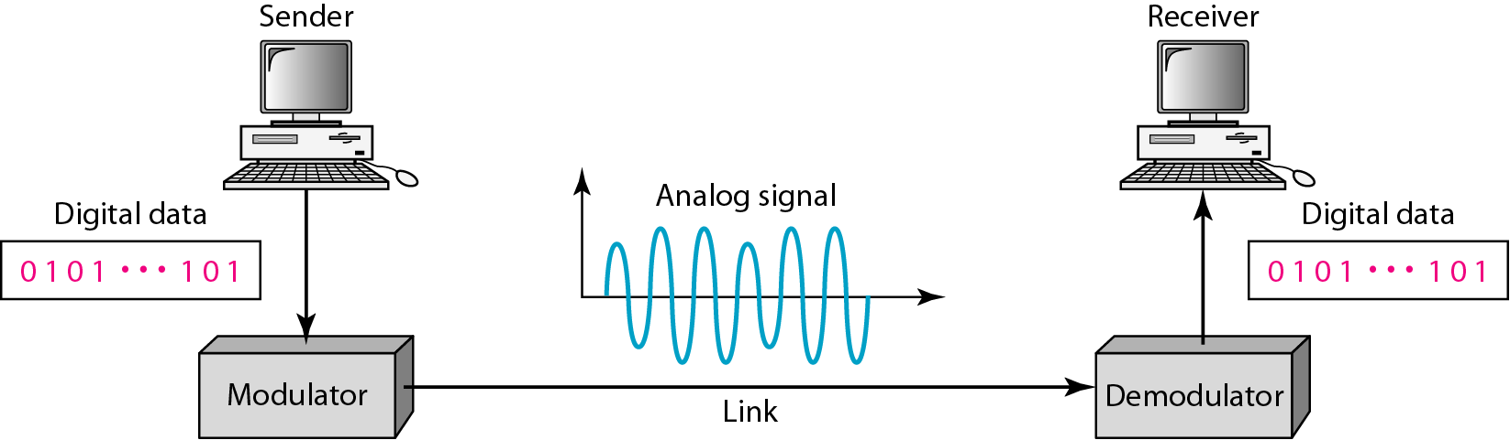
Figure 5.1 Digital-to-analog conversion

Slide 4
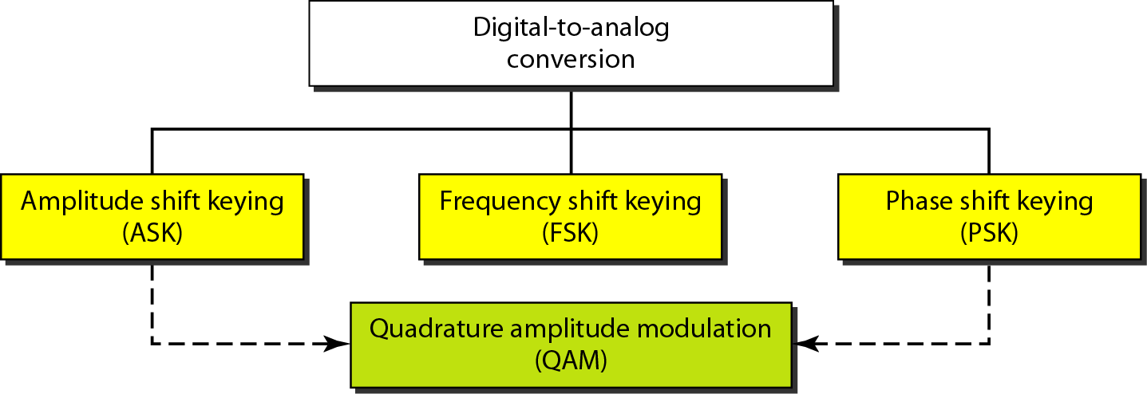
Figure 5.2 Types of digital-to-analog conversion

Slide 5

Note
Bit rate is the number of bits per second. Baud rate is the number of signal
elements per second.
In the analog transmission of digital data, the baud rate is less than or equal to the bit rate.

Slide 6
Example 5.1
An analog signal carries 4 bits per signal element. If 1000 signal elements are sent per second, find the bit rate.
Solution
In this case, r = 4, S = 1000 (signal rate, or baud), and N (the bit rate) is unknown. We can find the value of N from

Slide 7
Example 5.2
An analog signal has a bit rate of 8000 bps and a baud rate of 1000 baud. How many data elements are carried by each signal element? How many signal elements do we need?
Solution
In this example, S = 1000baud, N = 8000bps, and r and L are unknown. We find first the value of r and then the value of L.

Slide 8
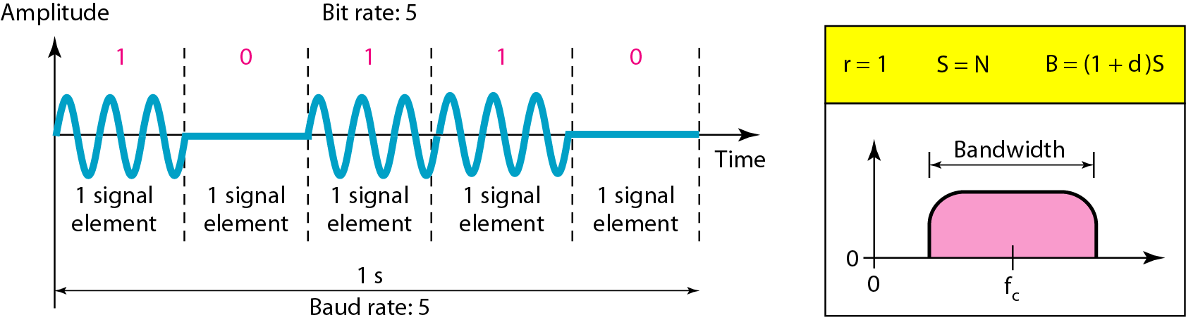
Amplitude Shift Keying
Binary amplitude shift keying
How many times does the wave cycle before we can tell a 0 from a 1?
Forouzan calls this d which is a constant between 0 and 1.
With BASK, d = 1
Figure 5.3
Note: 1 bit per signal change (r=1)

Slide 9
Example 5.3
In English – with amplitude modulation, signal has to cycle at least twice to interpret as a 1 or 0.
So bit rate is often ½ the bandwidth (or bandwidth is 2x bit rate).

Slide 10
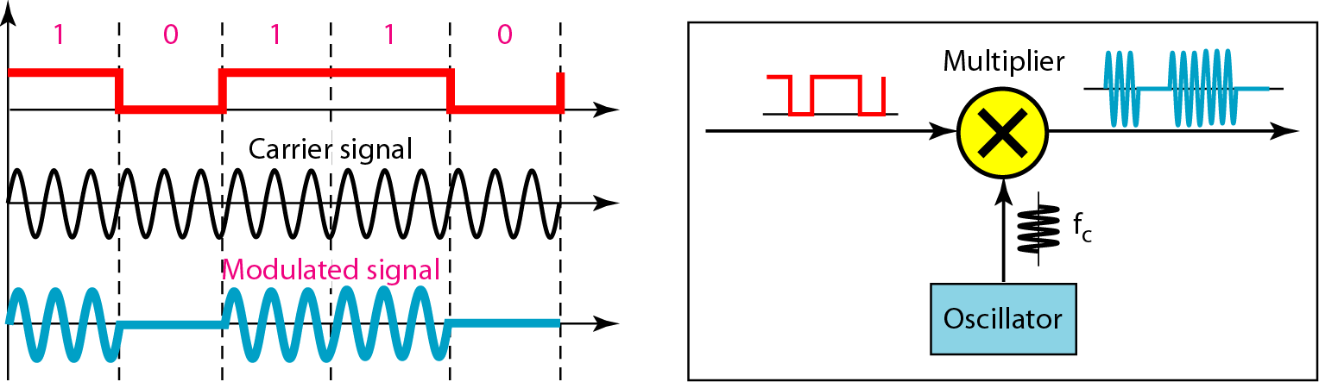
Figure 5.4 Implementation of binary ASK (BASK)

Slide 11
Example 5.3
We have an available bandwidth of 100 kHz which spans from 200 to 300 kHz. What are the carrier frequency and the bit rate (N) if we modulated our data by using ASK with d = 1?
Solution
The middle of the bandwidth is located at 250 kHz. This means that our carrier frequency can be at f_{c} = 250 kHz. We can use the formula for bandwidth to find the bit rate (with d = 1 and r = 1). (next slide)

Slide 12
Example 5.3
Bandwidth = (1+d) x baud rate S
Don’t want to know baud rate S, we want to know bit rate N, so substitute S = N x 1/r (from slide 6)
Bandwidth = (1+d) x N x 1/r
100kHz = 2 x N x 1/1 (given r=1 and d=1)
100kHz = 2 x N
N = 50 kbps

Slide 13
Example 5.4
In data communications, we often use full-duplex links with communication in both directions.
Some times we need to divide the bandwidth into two with two carrier frequencies, as shown in Figure 5.5. (Some times we are given two separate channels.)
The figure shows the positions of two carrier frequencies and the bandwidths.
The available bandwidth for each direction is now 50 kHz, which leaves us with a data rate of 25 kbps in each direction.

Slide 14
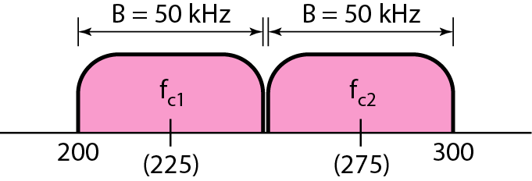
Figure 5.5 Bandwidth of full-duplex ASK used in Example 5.4

Slide 15
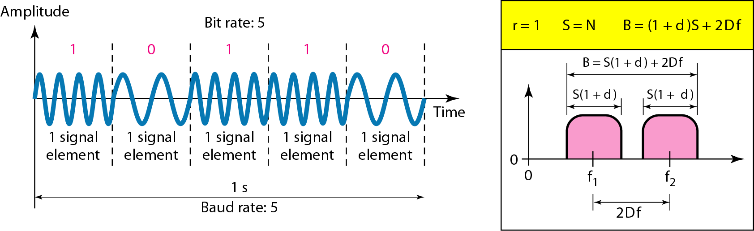
Frequency Shift Keying
Binary frequency shift keying (BFSK)
Figure 5.6
d = 1 for BFSK

Slide 16
Example 5.5
We have an available bandwidth of 100 kHz which spans from 200 to 300 kHz. What should be the carrier frequency and the bit rate if we modulated our data by using FSK with d = 1?
Solution
This problem is similar to Example 5.3, but we are modulating by using FSK. The midpoint of the band is at 250 kHz. We choose 2Δf to be 50 kHz; this means…

Slide 17
Example 5.5
Bandwidth = (1+d) x Baud Rate S + 2Δf
Given: 2Δf = 50kHz; d=1; Bandwidth = 100kHz
100kHz = (1+d) x S + 50kHz
50kHz = 2S
S = 25kbaud
Data rate N = Baud Rate S x r = 25kbps

Slide 18
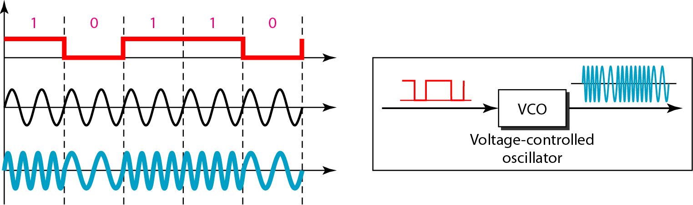
Figure 5.7 Implementation of BFSK

Slide 19
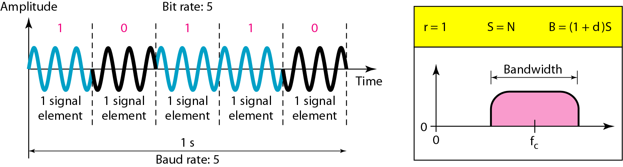
Phase Shift Keying
Binary phase shift keying (BPSK)
Figure 5.9
d = 0 for PSK

Slide 20
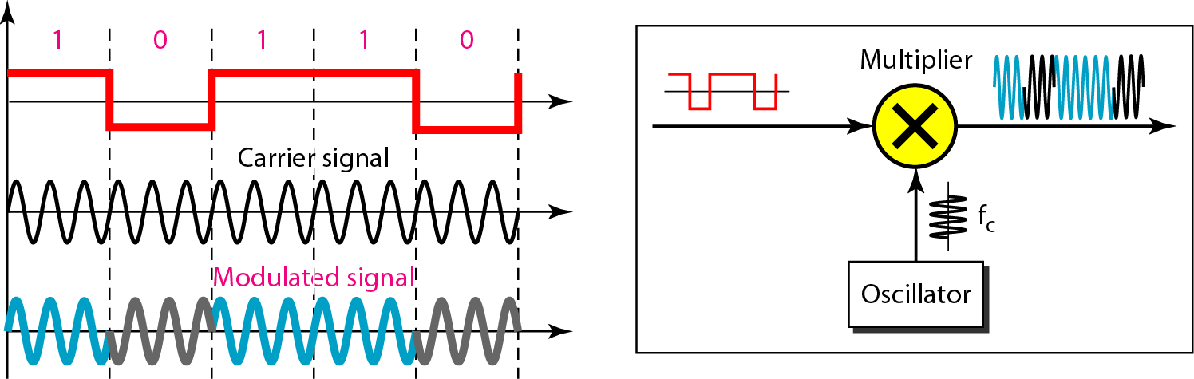
Figure 5.10 Implementation of BPSK

Slide 21
QPSK
But phase shift keying is more stable than either amplitude
shift keying or frequency shift keying.
So we can create systems that use more than two phase
angles. What about a system that has 4 phase angles?
QPSK (Quadrature Phase Shift Keying)
Phase shifts occur on the 45, 135, 225, and 315 degrees.

Slide 22
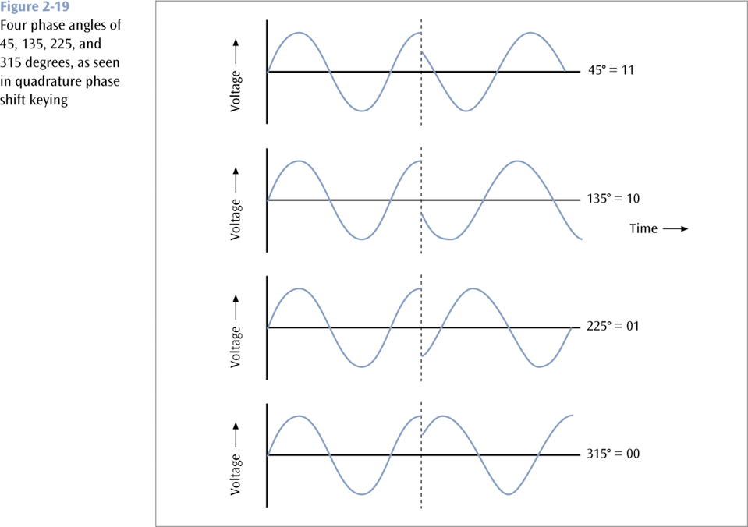
QPSK
How many bits per
signal change?
(What is r?)

Slide 23
Example 5.7
Find the bandwidth for a signal transmitting at 12 Mbps for QPSK. The value of d = 0.
Solution
For previous example of QPSK, 2 bits is carried by one signal element. This means that r = 2. So the signal rate (baud rate) is S = N × (1/r) = 6 Mbaud. With a value of d = 0, we have B = S = 6 MHz.

Slide 24
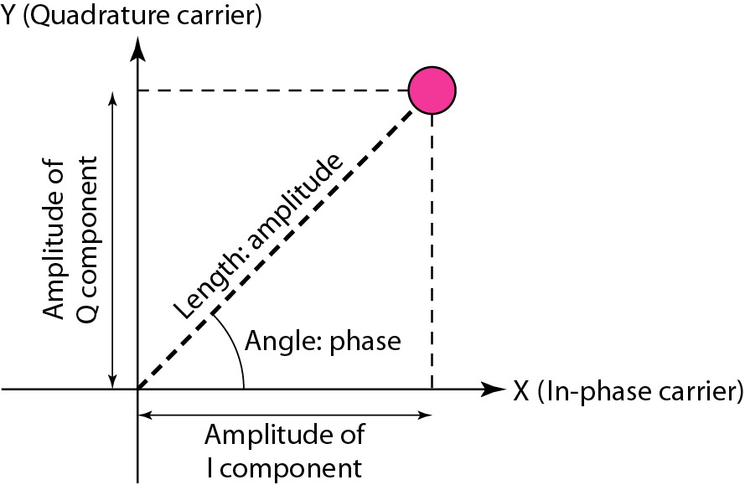
Constellation diagram
Figure 5.12 Concept of a constellation diagram

Slide 25
Example 5.8
Show the constellation diagrams for an ASK, BPSK, and QPSK signals.
Solution
Figure 5.13 shows the three constellation diagrams.

Slide 26
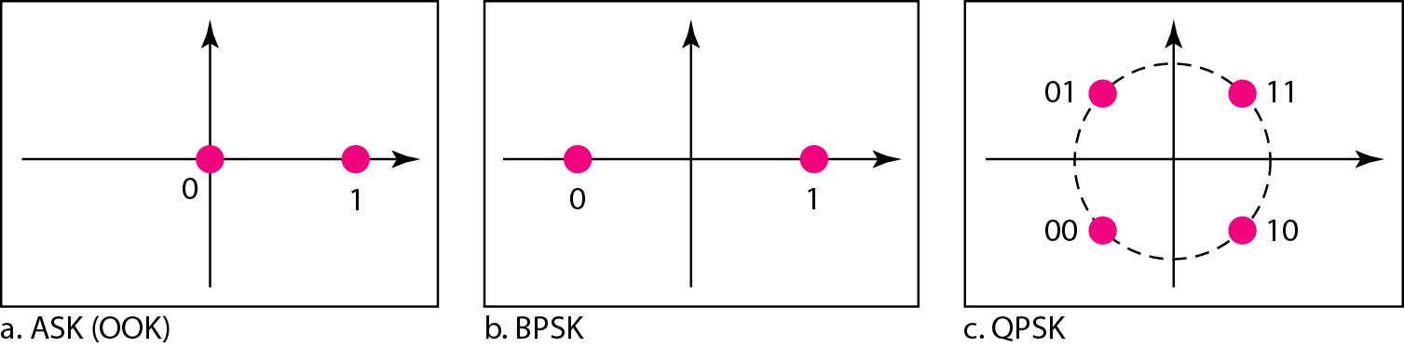
Figure 5.13 Three constellation diagrams

Slide 27
Note
Quadrature amplitude modulation is a combination of ASK and PSK.

Slide 28
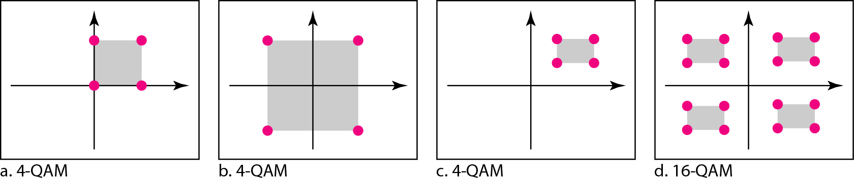
Figure 5.14 Constellation diagrams for some QAMs

Slide 29
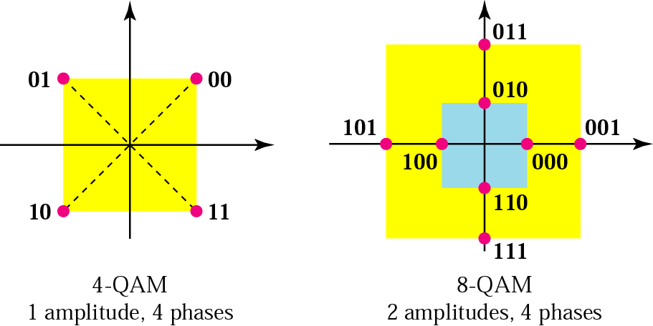
The 4-QAM and 8-QAM constellations

Slide 30
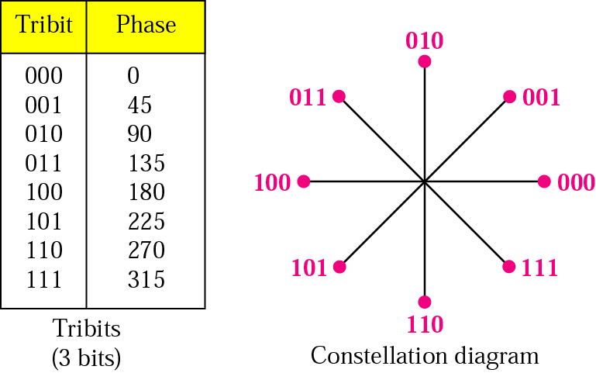
The 8-PSK characteristics

Slide 31
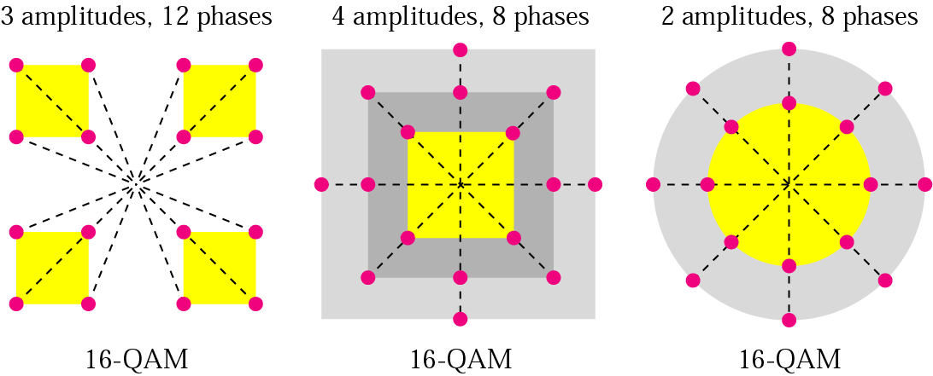
16-QAM constellations

Slide 32
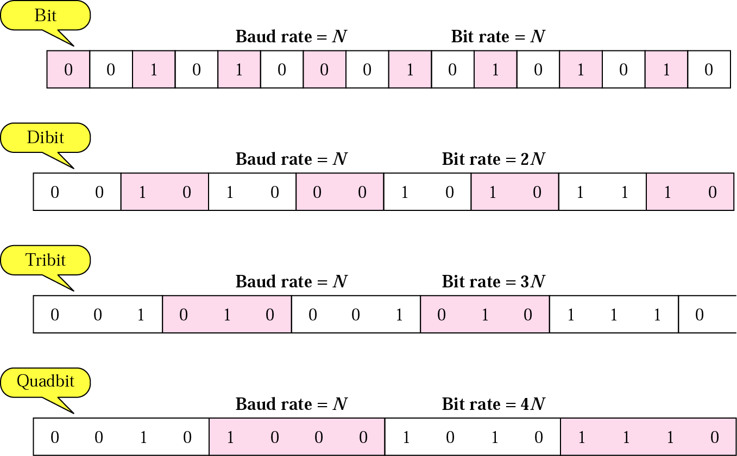
Bit and baud

Slide 33
Table 5.1 Bit and baud rate comparison
Modulation | Units | Bits/Baud | Baud rate | Bit Rate
ASK, FSK, 2-PSK | Bit | 1 | N | N
4-PSK, 4-QAM | Dibit | 2 | N | 2N
8-PSK, 8-QAM | Tribit | 3 | N | 3N
16-QAM | Quadbit | 4 | N | 4N
32-QAM | Pentabit | 5 | N | 5N
64-QAM | Hexabit | 6 | N | 6N
128-QAM | Septabit | 7 | N | 7N
256-QAM | Octabit | 8 | N | 8N

Slide 34
Example
A constellation diagram consists of eight equally spaced points on a circle. If the bit rate is 4800 bps, what is the baud rate?
Solution
The constellation indicates 8-PSK with the points 45 degrees apart. Since 2³ = 8, 3 bits are transmitted with each signal unit. Therefore, the baud rate is
4800 / 3 = 1600 baud

Slide 35
Example
Compute the bit rate for a 1000-baud 16-QAM signal.
Solution
A 16-QAM signal has 4 bits per signal unit since
log₂16 = 4.
Thus,
(1000)(4) = 4000 bps

Slide 36
Example
Compute the baud rate for a 72,000-bps 64-QAM signal.
Solution
A 64-QAM signal has 6 bits per signal unit since
log₂ 64 = 6.
Thus,
72000 / 6 = 12,000 baud

Slide 37
A telephone line has a bandwidth of almost 2400 Hz for data transmission.

Slide 38
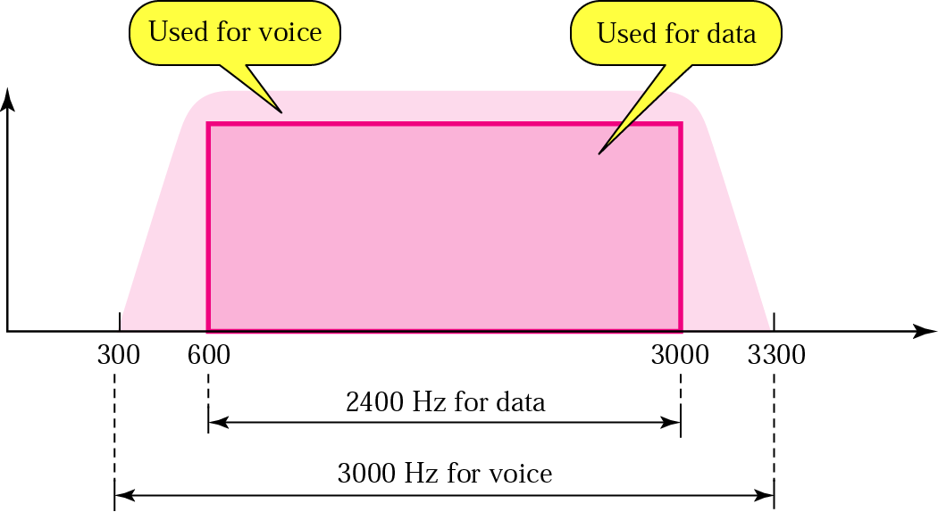
Telephone line bandwidth

Slide 39
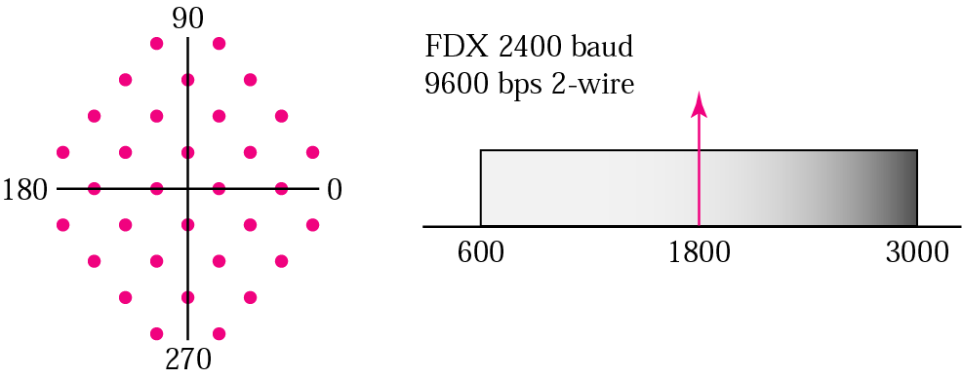
The V.32 constellation and bandwidth

Slide 40
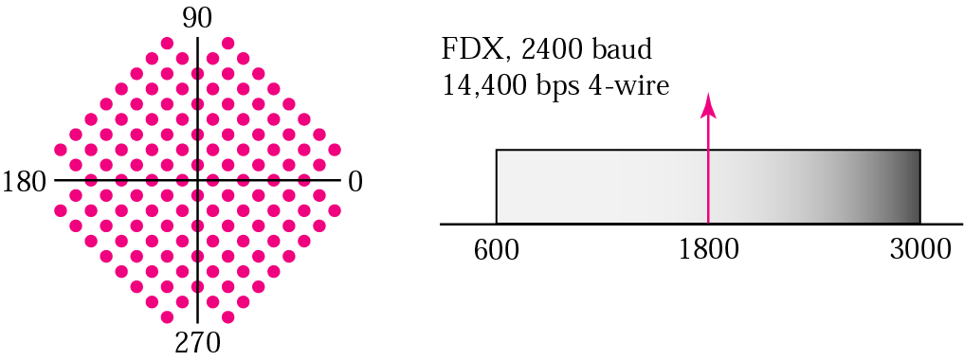
The V.32bis constellation and bandwidth

Slide 41
5-2 ANALOG TO ANALOG CONVERSION
Analog-to-analog conversion is the representation of analog information by an analog signal. One may ask why we need to modulate an analog signal; it is already analog. Modulation is needed if the medium is bandpass in nature or if only a bandpass channel is available to us.
Topics discussed in this section:
Amplitude Modulation Frequency Modulation Phase Modulation

Slide 42
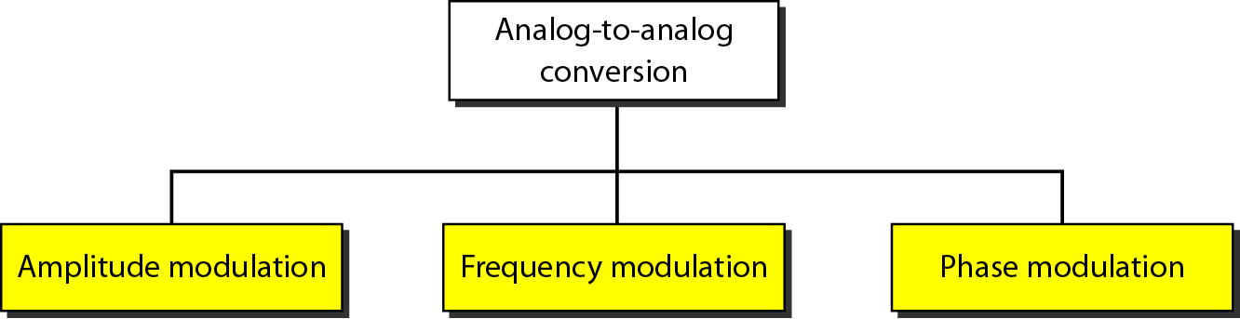
Figure 5.15 Types of analog-to-analog modulation

Slide 43
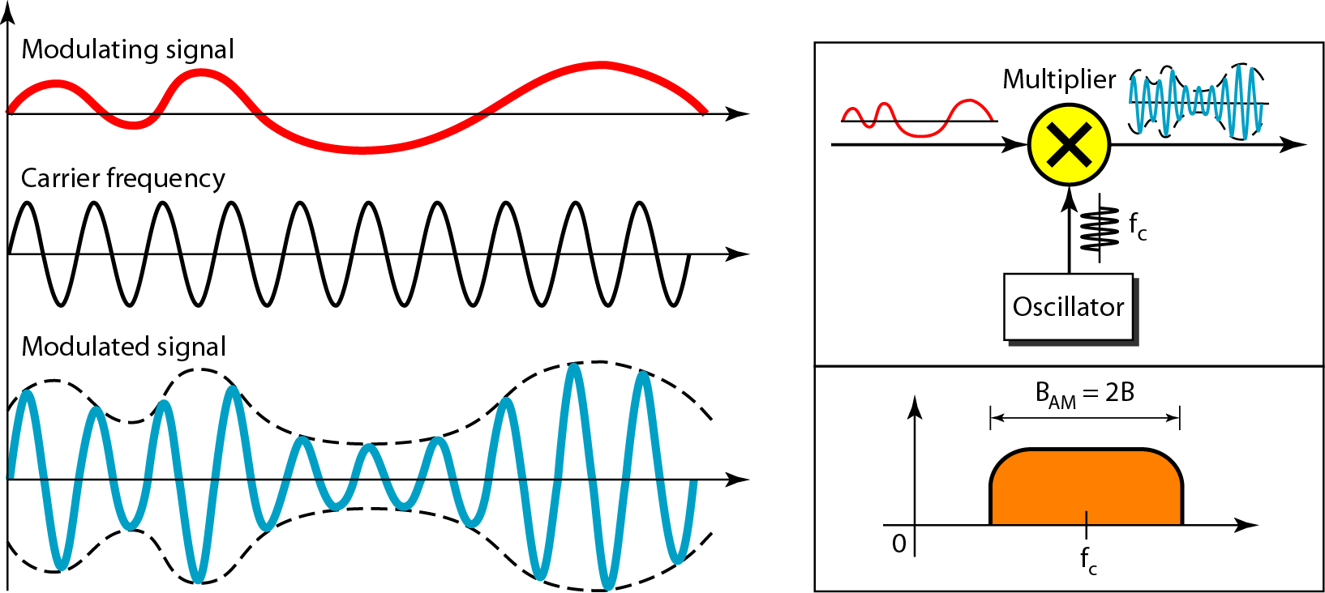
Figure 5.16 Amplitude modulation

Slide 44
Note
The total bandwidth required for AM can be determined
from the bandwidth of the audio signal: B_{AM} = 2B.

Slide 45
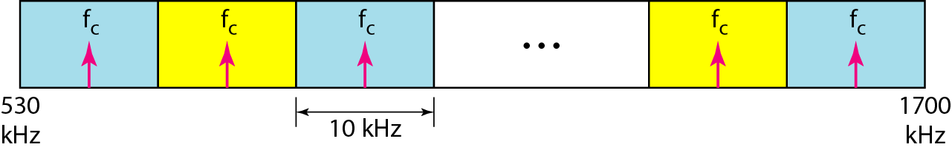
Figure 5.17 AM band allocation

Slide 46
Note
The total bandwidth required for FM can be determined from the bandwidth of the audio signal: B_{FM} = 2(1 + β)B.

Slide 47
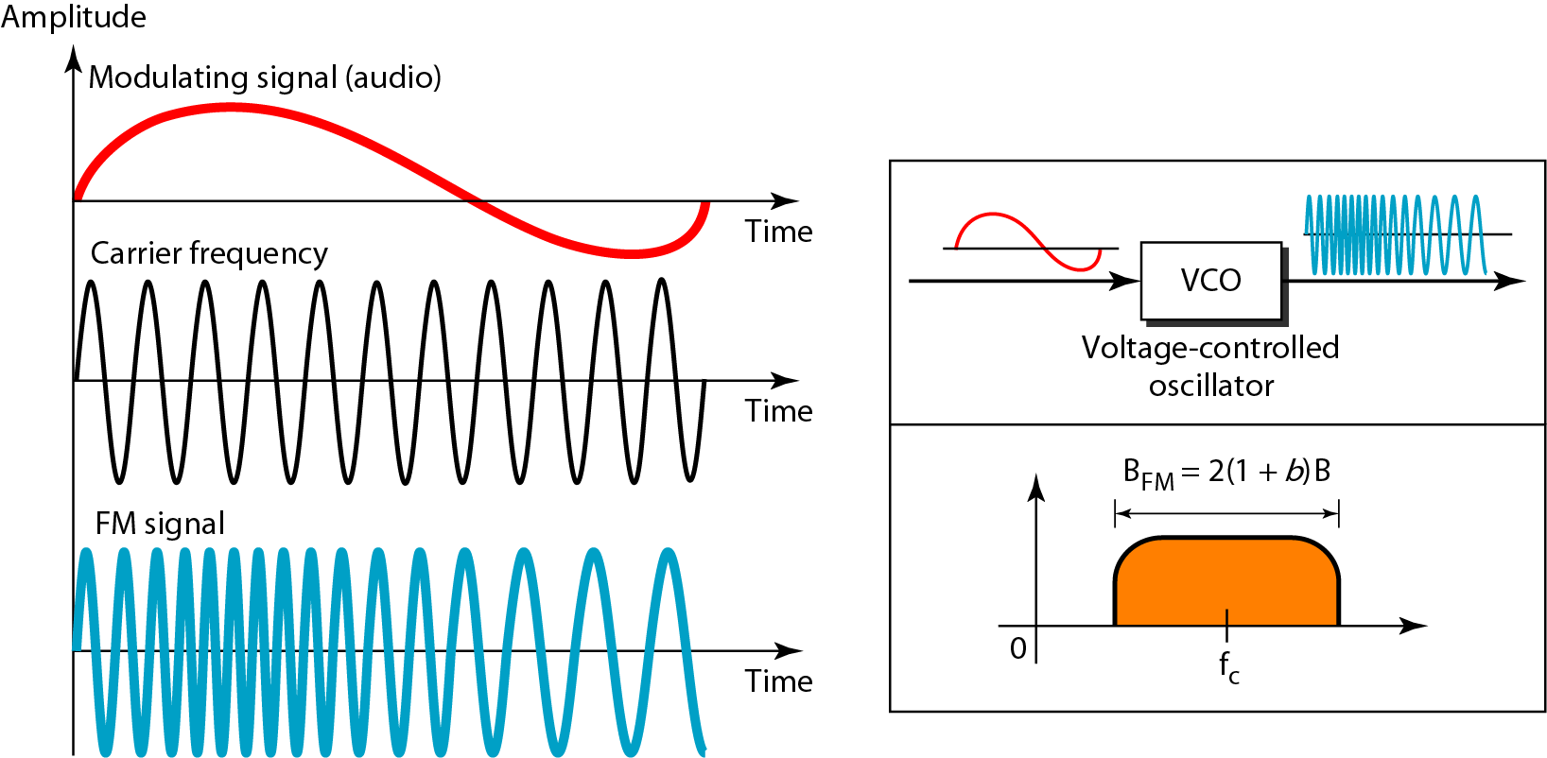
Figure 5.18 Frequency modulation

Slide 48
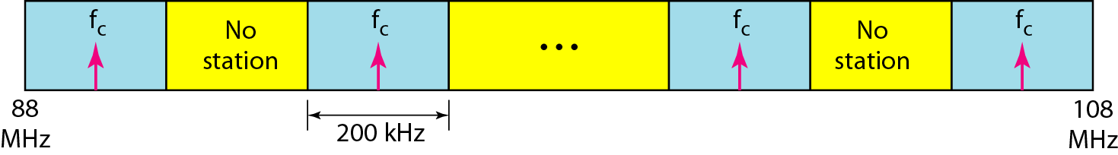
Figure 5.19 FM band allocation

Slide 49
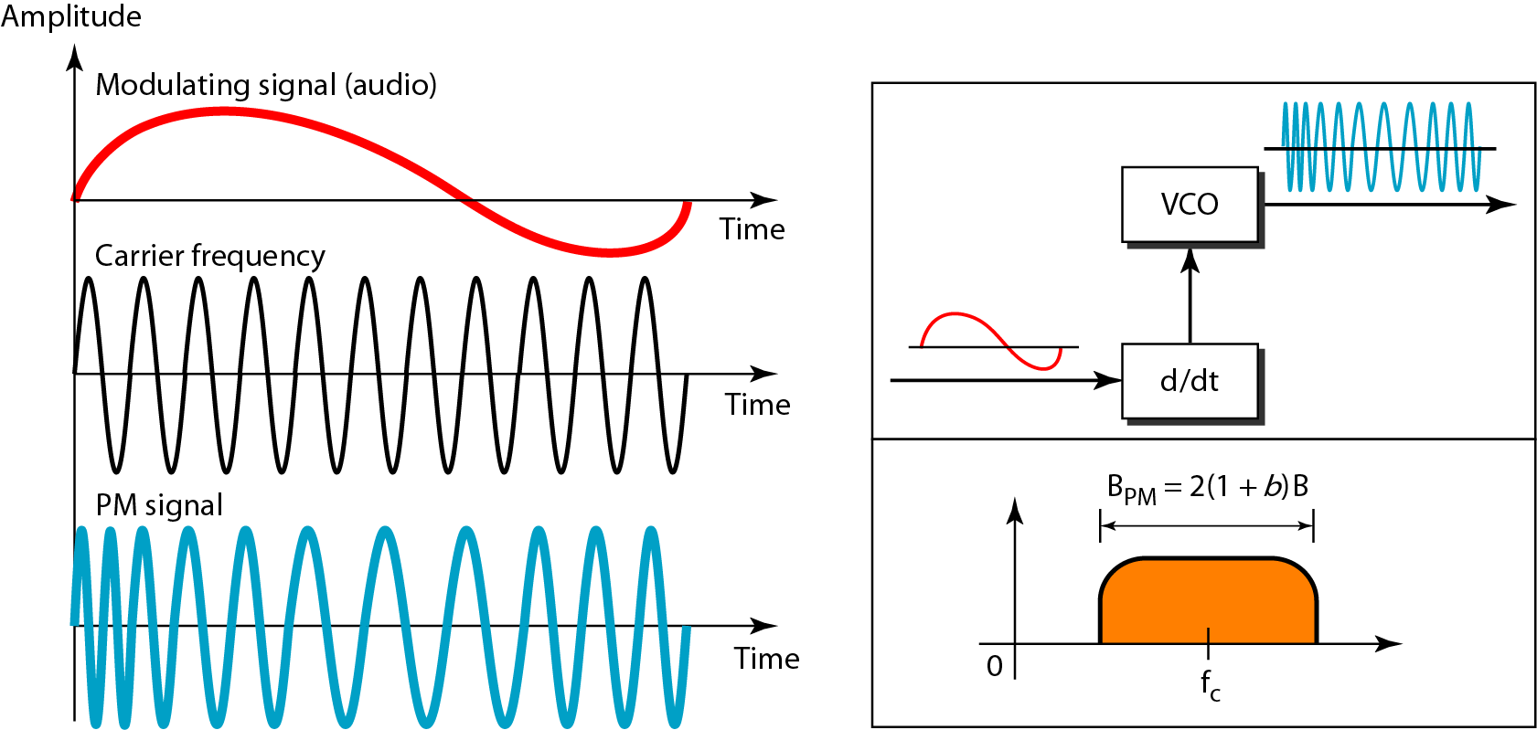
Figure 5.20 Phase modulation

Slide 50
Note
The total bandwidth required for PM can be determined from the bandwidth and maximum amplitude of the modulating signal: B_{PM} = 2(1 + β)B.

Slide 51
Summary
Given available bandwidth, what are the carrier frequency and the bit rate if we modulated our data by using ASK with d = 1? (Example 5.3)
We have an available bandwidth of 100 kHz which spans from 200 to 300 kHz. What should be the carrier frequency and the bit rate if we modulated our data by using FSK with d = 1? (Example 5.5)

Slide 52
Summary
Find the bandwidth for a signal transmitting at 12 Mbps for QPSK. The value of d = 0. (Example 5.7)
Be able to create a constellation pattern

